Slide 1
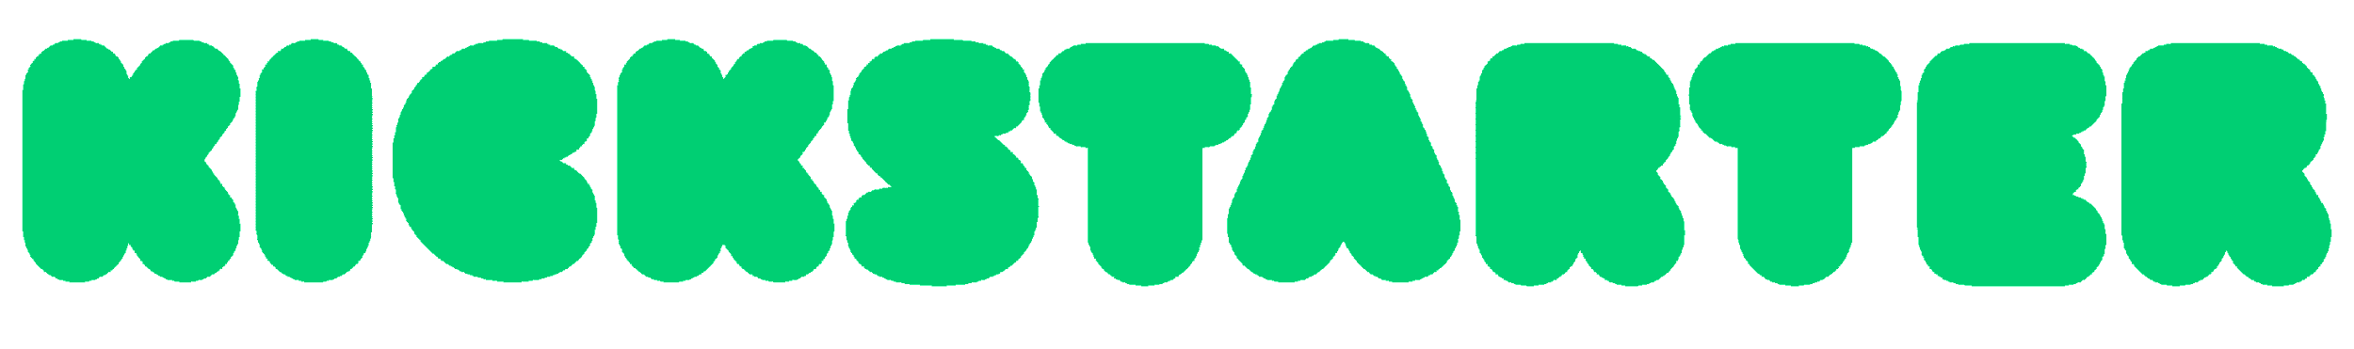
DATA SCIENCE IMMERSIVE ADMISSIONS TASK
By Feng Weihan
HOW TO MAKE YOUR
CAMPAIGN A SUCCESS
Kickstarter Dataset

Slide 2
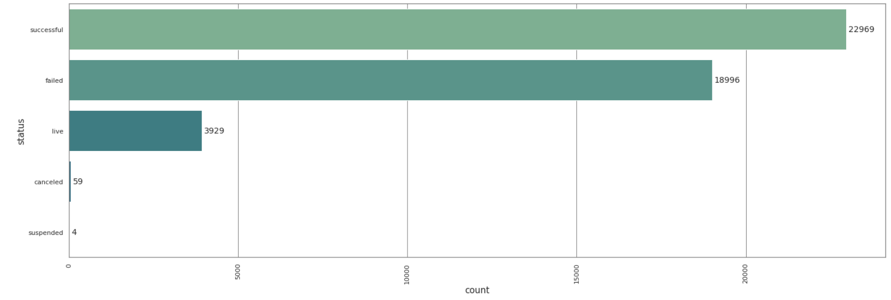
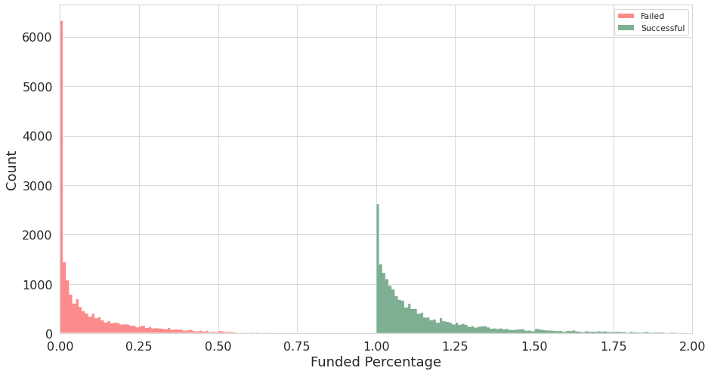
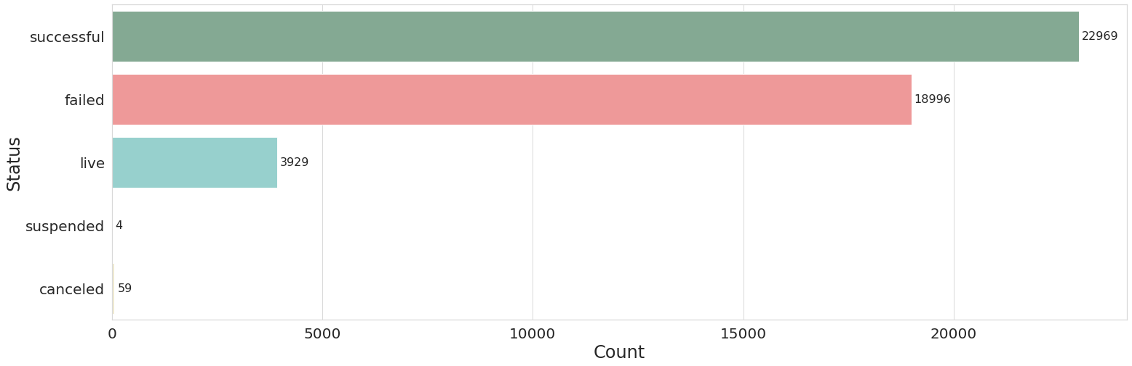
Defining Success
55% - 45%
More projects succeed than fail
For the purpose of this analysis, we will focus on just the successful and failed projects
Many projects hardly receive any pledges – 15% of all projects achieved <1% of goal
For projects that failed, they failed by a rather large margin (50%).
For projects that succeed, it is still rare to surpass your goal by > 50% - only 8.8% of all projects
Be Optimistic
But…
Set Realistic Expectations
Notes:
Suspension: A project may be suspended if our Trust & Safety team uncovers evidence that it is in violation of Kickstarter's rules, including: Misrepresentation of support, through self-pledging. Misrepresentation or failure to disclose relevant facts about the project or its creator

Slide 3
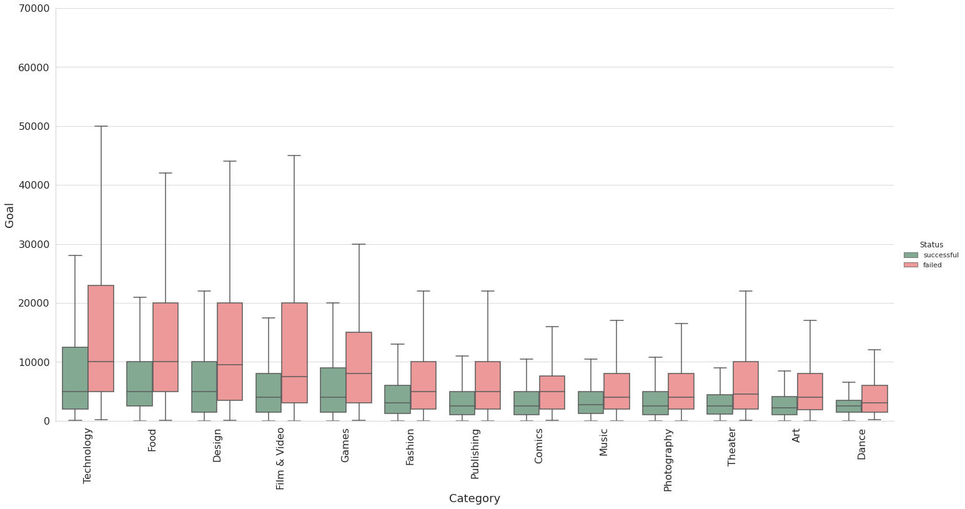
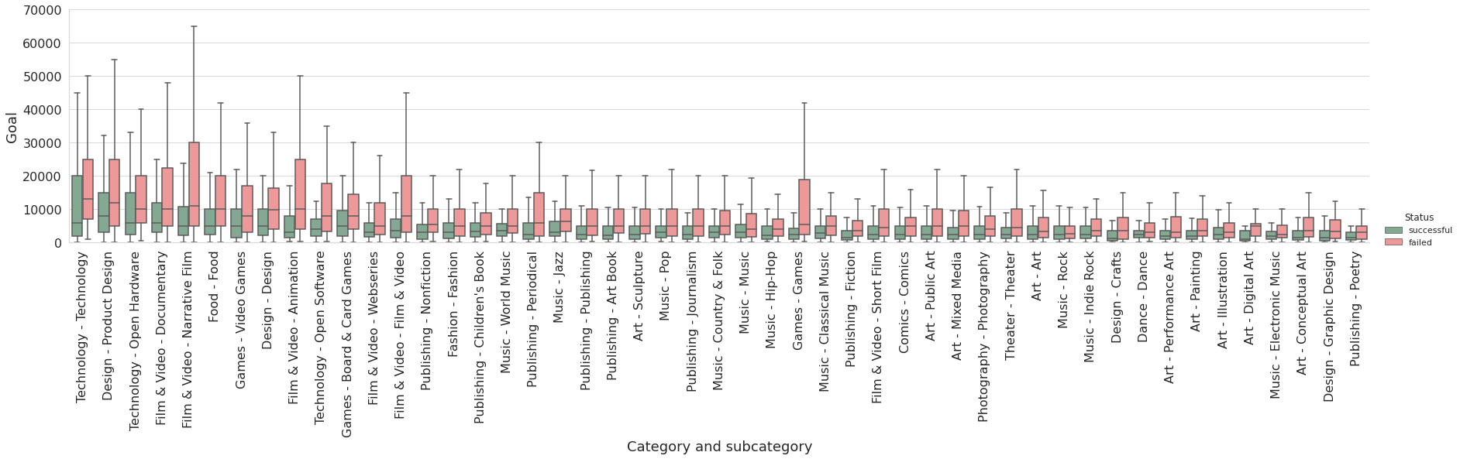
Goal Setting
Generally, projects in technology, food, design, film & video and games tend to set higher goals
Projects that succeeded tend to set lower goals across all subcategories than projects that failed
Ask for just enough
Category and subcategory | Art - Art | Art - Conceptual Art | Art - Digital Art | Art - Illustration | Art - Mixed Media | Art - Painting | Art - Performance Art | Art - Public Art | Art - Sculpture | Comics - Comics | Dance - Dance | Design - Crafts | Design - Design | Design - Graphic Design | Design - Product Design | Fashion - Fashion | Film & Video - Animation | Film & Video - Documentary | Film & Video - Film & Video | Film & Video - Narrative Film | Film & Video - Short Film | Film & Video - Webseries | Food - Food | Games - Board & Card Games | Games - Games | Games - Video Games | Music - Classical Music | Music - Country & Folk | Music - Electronic Music | Music - Hip-Hop | Music - Indie Rock | Music - Jazz | Music - Music | Music - Pop | Music - Rock | Music - World Music | Photography - Photography | Publishing - Art Book | Publishing - Children's Book | Publishing - Fiction | Publishing - Journalism | Publishing - Nonfiction | Publishing - Periodical | Publishing - Poetry | Publishing - Publishing | Technology - Open Hardware | Technology - Open Software | Technology - Technology | Theater - Theater
Median Goal – Successful | 2500 | 1500 | 1000 | 2500 | 2400 | 2000 | 2000 | 2500 | 2500 | 2500 | 2500 | 1200 | 5000 | 1500 | 8000 | 3000 | 3200 | 6000 | 3500 | 5000 | 2500 | 3000 | 5000 | 5000 | 2500 | 5000 | 2750 | 3000 | 2000 | 2100 | 2500 | 3150 | 3000 | 3000 | 2400 | 3467 | 2500 | 2200 | 3288 | 1500 | 2500 | 3000 | 2500 | 1500 | 2500 | 6000 | 4048 | 6000 | 2500
Median Goal - Failed | 3317 | 3500 | 5000 | 3000 | 5000 | 3500 | 3000 | 5000 | 5000 | 5000 | 3000 | 3500 | 9950 | 3250 | 12000 | 5000 | 10000 | 10000 | 7900 | 11000 | 4500 | 5000 | 10000 | 8000 | 5500 | 8000 | 5000 | 5000 | 2500 | 4000 | 3500 | 6250 | 4000 | 5000 | 2650 | 5000 | 4000 | 5000 | 5000 | 3500 | 5000 | 5500 | 6000 | 3000 | 5000 | 10000 | 8000 | 13000 | 4500

Slide 4
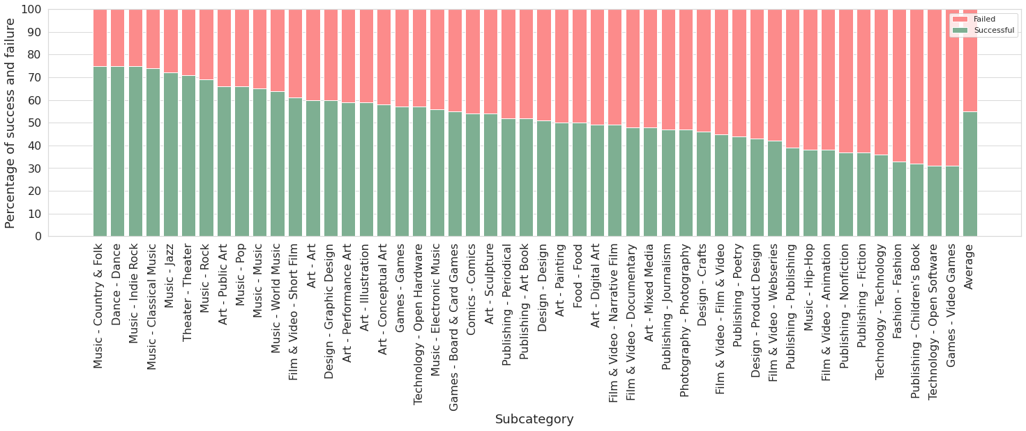
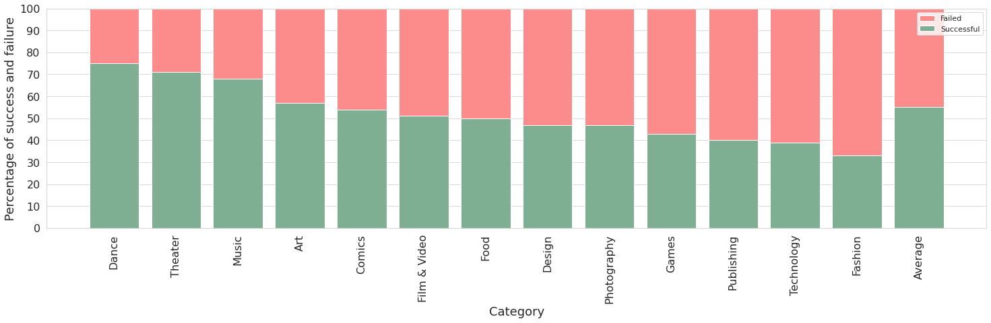
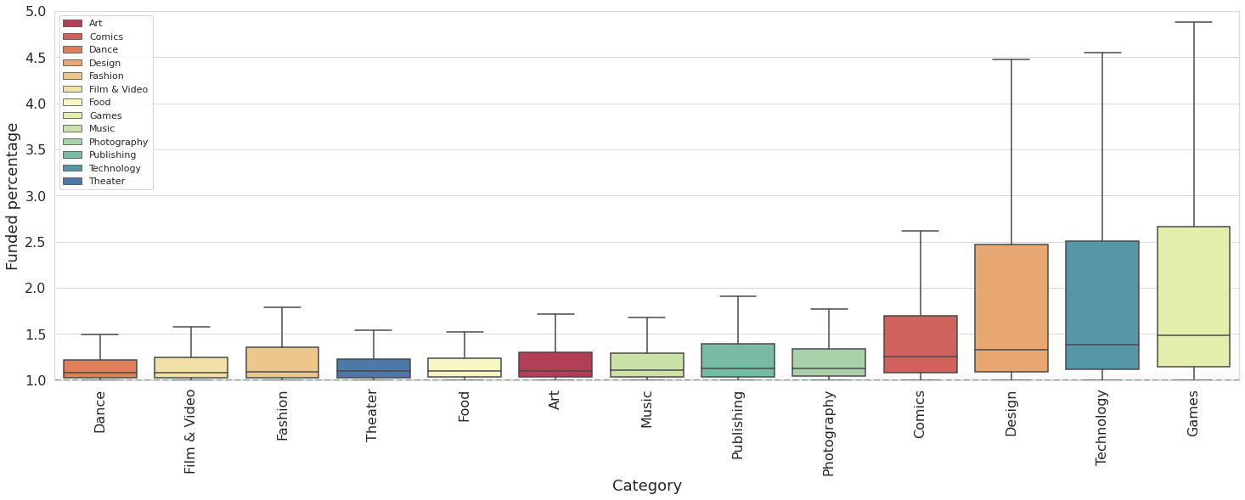
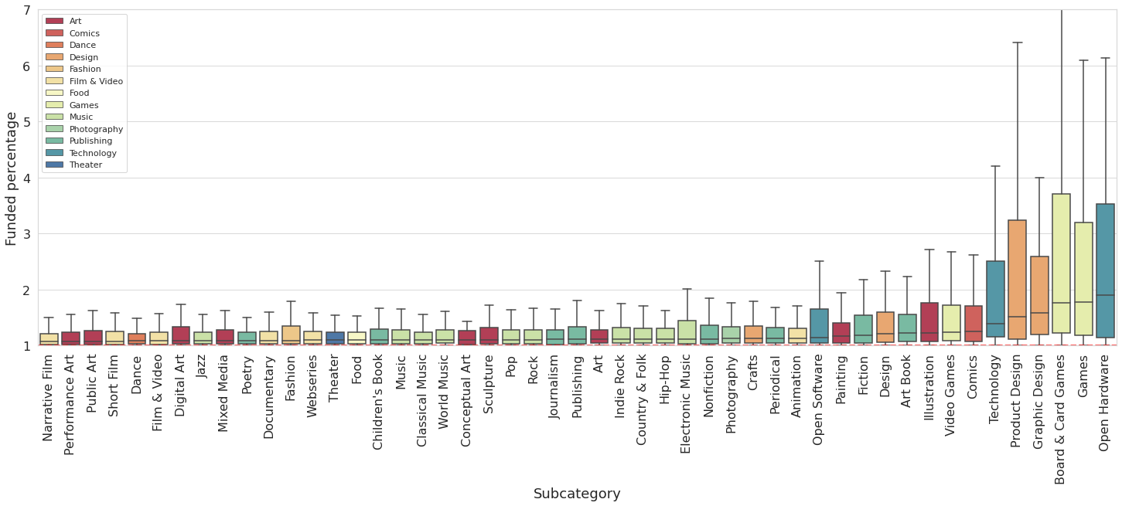
Choosing Your Project
Choosing Your Project
You are more likely to succeed with artistic projects, such as dance, theatre, music and art, however, they tend not to exceed the goal by too much – lower risk, lower reward
You might not be as likely to succeed in games, technology, design and comics projects, but they tend to fetch a higher pledge relative to goal – higher risk, higher reward
You might want to rethink fashion projects, but don’t let me dissuade you – higher risk, lower reward
Notes:
Goal: boxen plot to show some

Slide 5
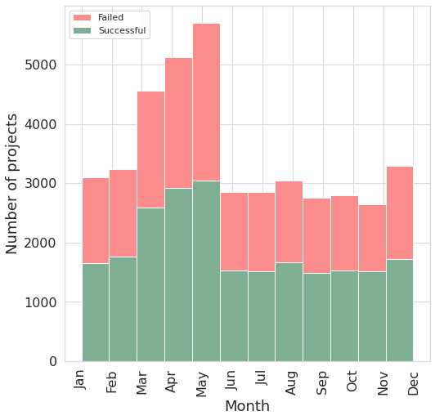
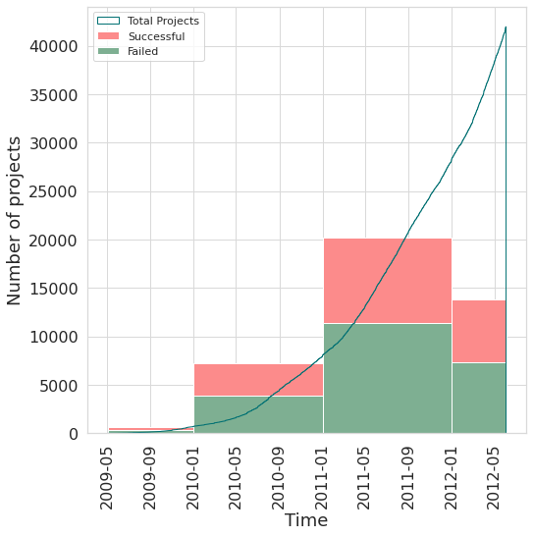
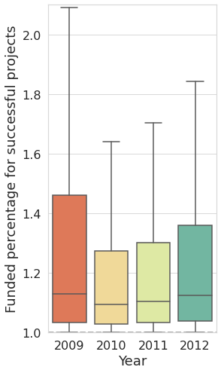
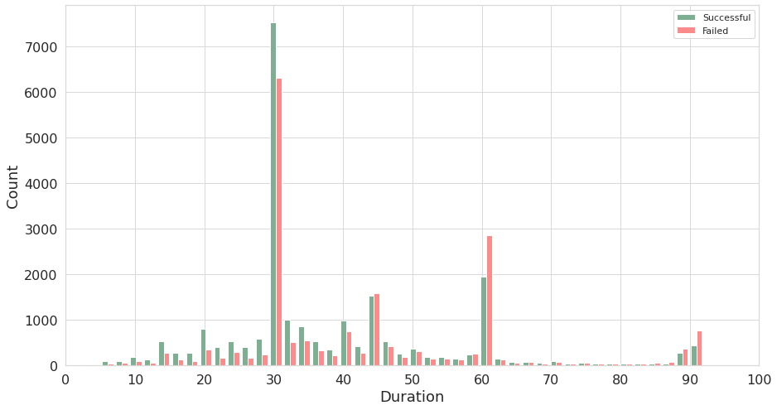
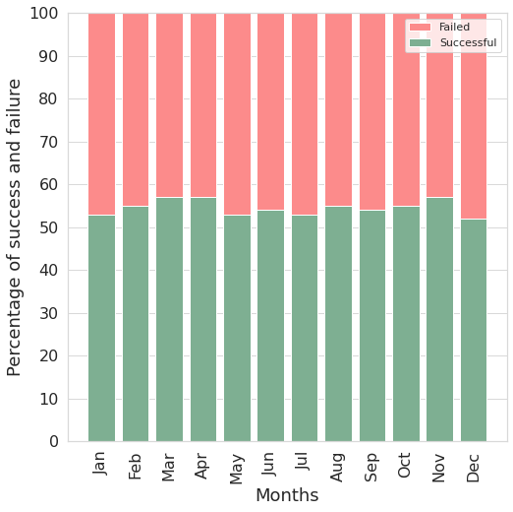
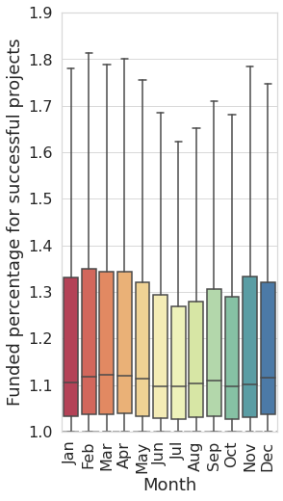
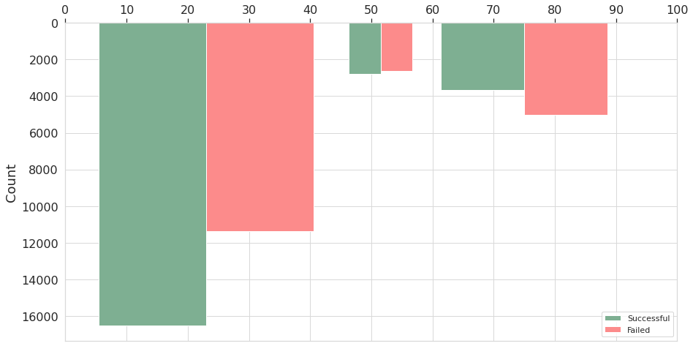
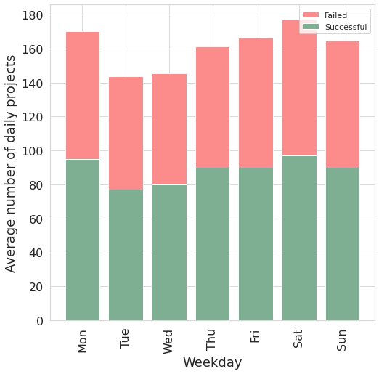
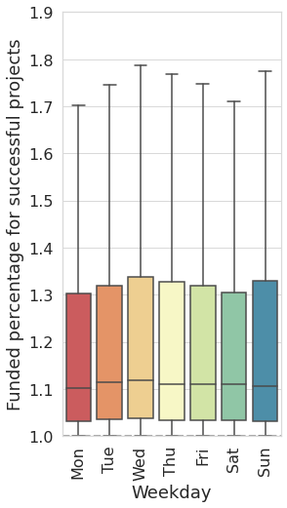
Longer is not always better
Time and Duration
Increasing rate of new projects
Success rate increased from 2009 to 2011
Projects are getting higher pledged amounts relative to goal
Year
56%
54%
53%
53%
Little difference in the chance of success across different months
Though successful projects which started from Nov to May do get a little more pledged amount relative to goal
Duration
Month
More projects are initiated as the week goes on
Though the days do not make a significant difference in your chance of success
More likely to succeed
Less Likely to succeed
Moderate
Weekday
Keep the duration <60 days, or better still, <45 days
Lesser projects with duration >60
Notes:
Duration: maybe shows confidence?

Slide 6
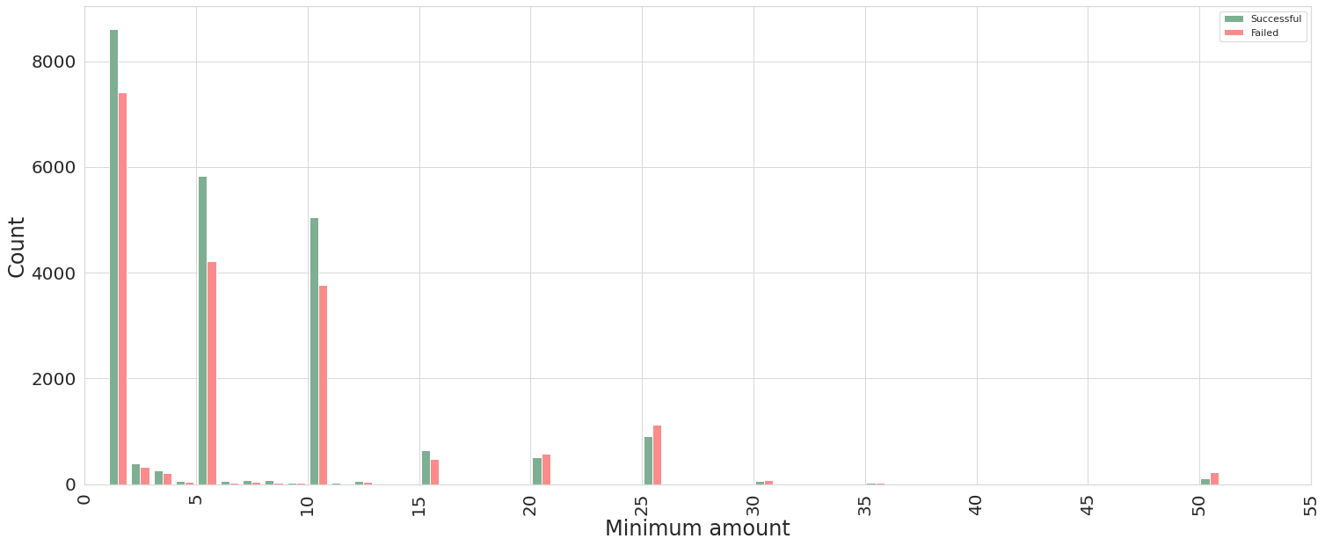
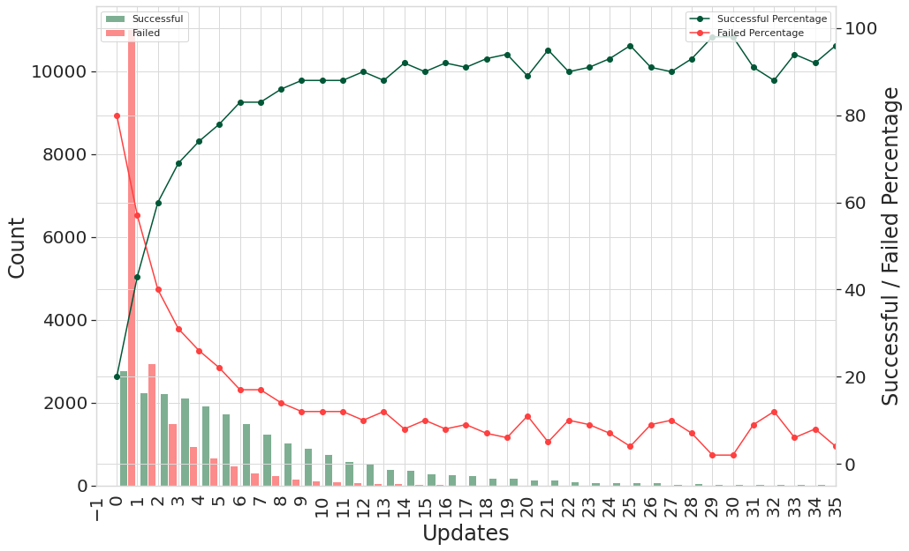
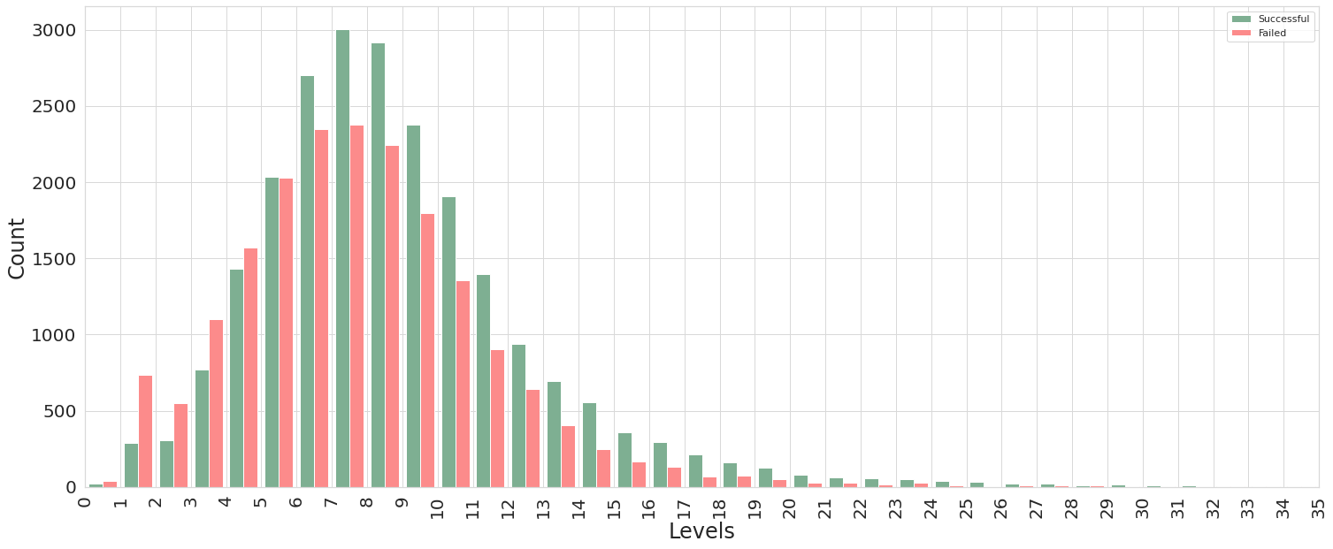
Engagement Is Key
Minimum Reward
Try to set minimum reward at $15 or less
Updates
33% of projects have 0 updates, 80% of those failed
Success rate increases as number of updates increase - 90% successful for projects with 12 updates
Reward Levels
You are more likely to succeed when there are > 5 reward levels – choice matters
Notes:
Duration: maybe shows confidence?

Slide 7
THANK
YOU

